Slide 1
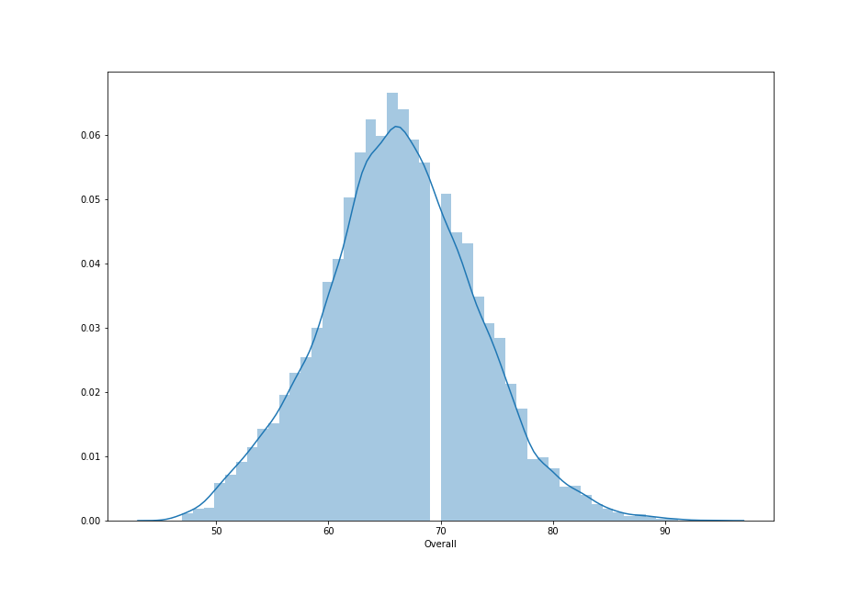
Distribution of Players with respective to Overall Rating

Slide 2
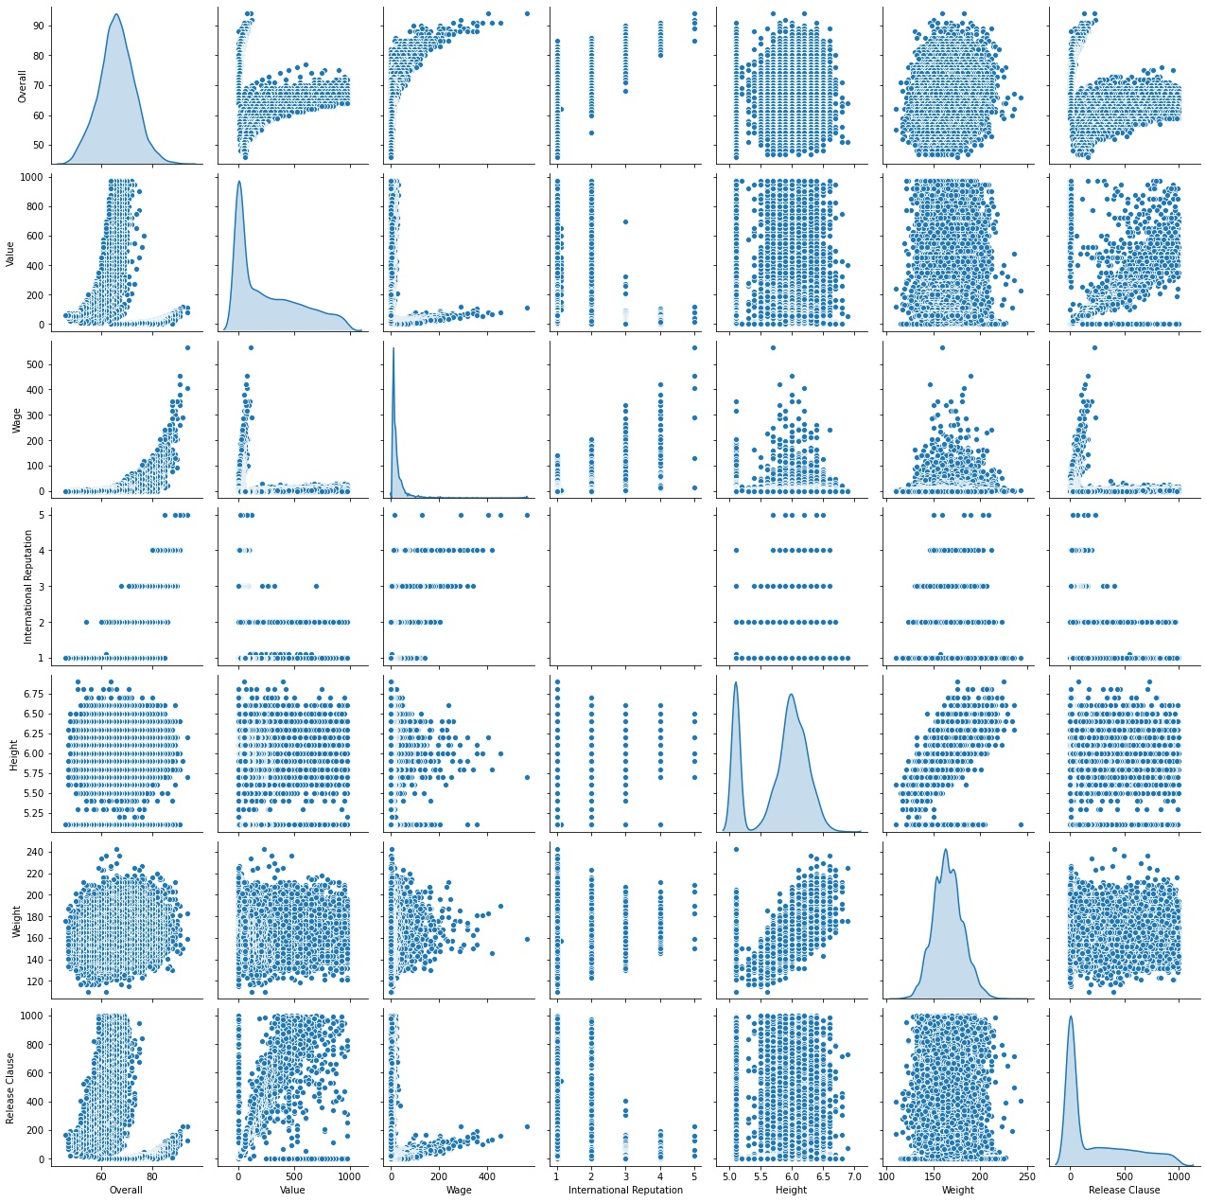
Pairplot of all the important variables

Slide 3
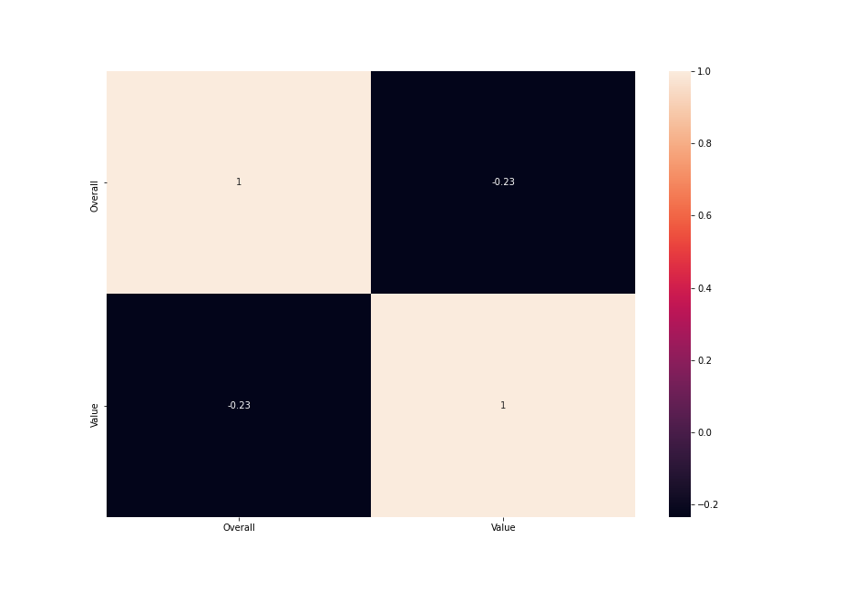
Correlation between value and Overall rating of player

Slide 4
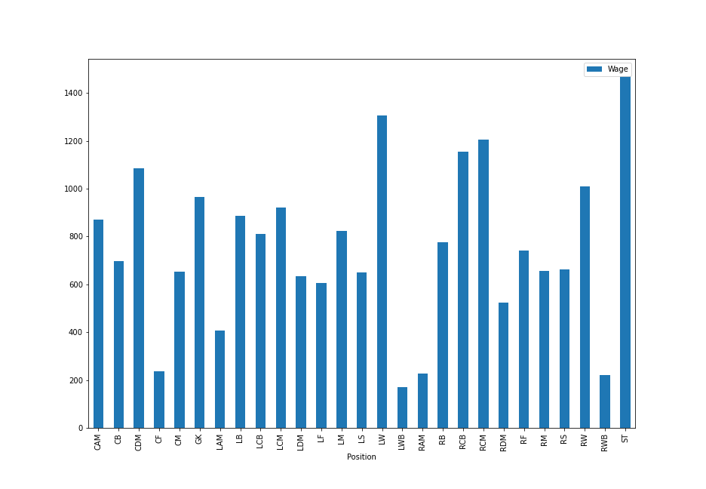
Average wages of top 5 players in each position

Slide 5
Inference-
Distribution of fooball players wrt overall ratings is Normal.
co-relation between overall rating and value of the player is poor.
Maximum wages are given to striker position and second highest to left wing where as minimum avg wage is given to LWB(Left winb back) position.

